Slide 1
Deep Learning Fundamentals & Pytorch Implementation
October 05, 2020
Alberto.Becerra@PredictLand.com
+34 680 22 52 60

Slide 2
Index
Gradient Descent
Logistic Regression
Introduction
Forward Pass
PyTorch
Neural Networks
Back Propagation

Slide 3
Index
Gradient Descent
Logistic Regression
Introduction
Forward Pass
PyTorch
Neural Networks
Back Propagation

Slide 4
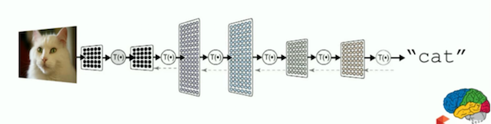
Introduction
What is a Neural Network?
An artificial neural network learning algorithm, or neural network, is a computational learning system that uses a network of functions to understand and translate a data input of one form into a desired output, usually in another form.
The concept of the artificial neural network was inspired by human biology and the way neurons of the human brain function together to understand inputs from human senses.
Generalized approach to problem solving. Some common applications:
Image/pattern recognition
Text mining
Medical diagnosis and cancer research

Slide 5


Introduction
Social Impact: News

Slide 6
Index
Gradient Descent
Logistic Regression
Introduction
Forward Pass
PyTorch
Neural Networks
Back Propagation

Slide 7
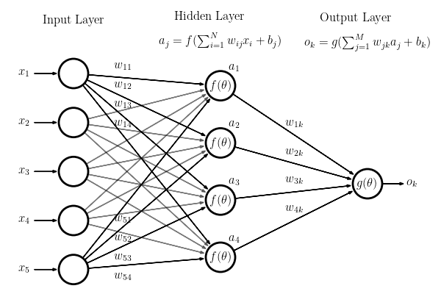
Neural Networks
Key Concepts
Architecture:
Neuron
Layer
Input Layer
Hidden Layers
Output Layer
Weights and Bias
Activation Function
Error/Loss Function
Gradient Descent
Backpropagation

Slide 8
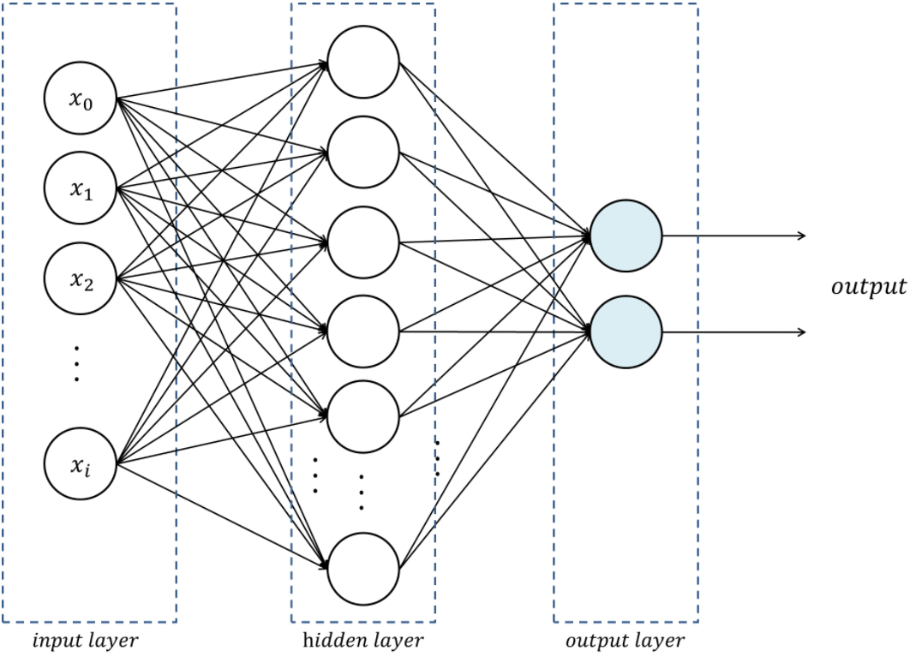
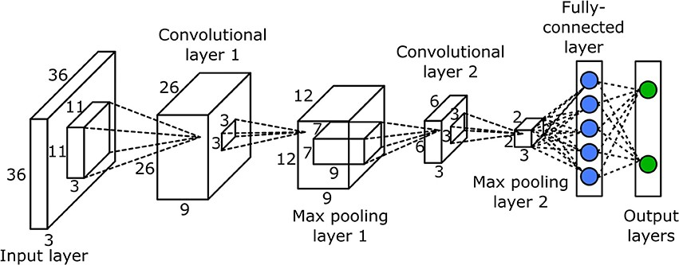
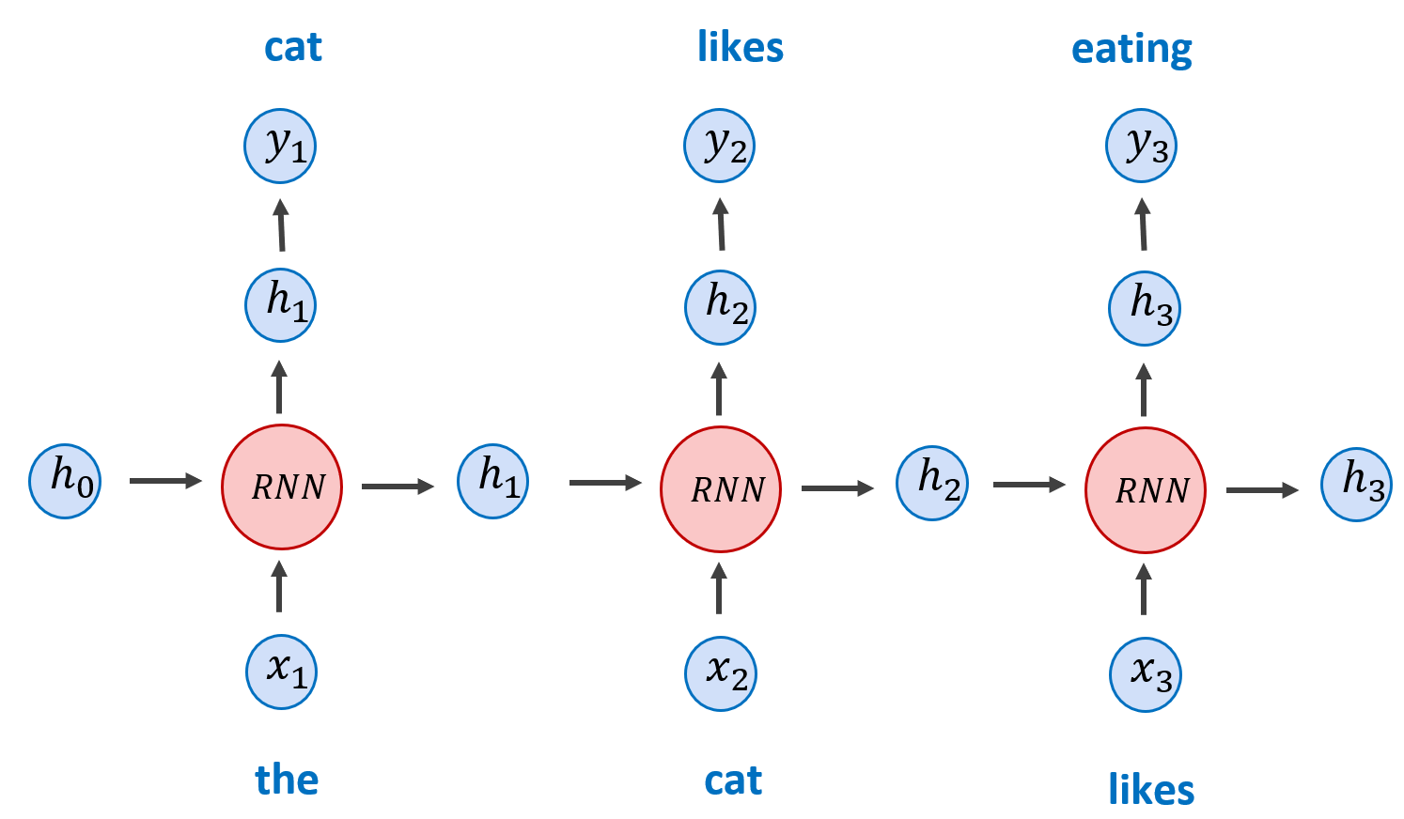
Neural Networks
Classification by Architecture
Feed Forward Neural Networks:
Fully Connected Layers
Frequent Input: Tabular Data,
Preprocessed Text, Simple Images, …
Convolutional Neural Networks
Convolutional Layers
Batch Normalization Layers
Pooling Layers
Frequent Input: Images
Recurrent Neural Networks
Memory Cells (LSTM, GRU, …)
Frequent Input: Text/Image/Audio Sequences

Slide 9
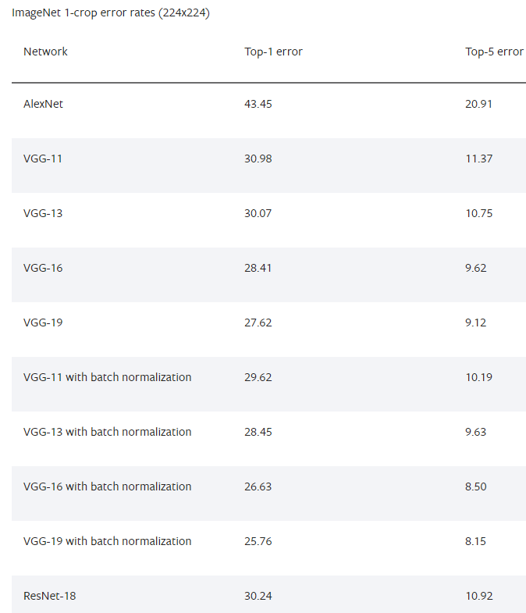
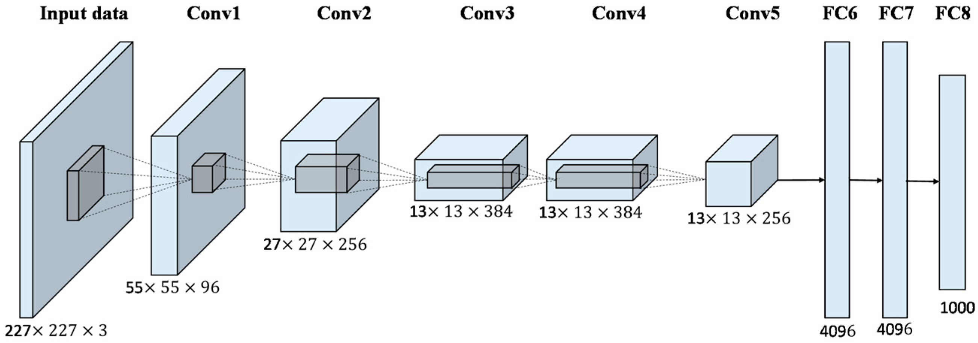
Neural Networks
Classification by Weights Update
AlexNet
Pre-Trained (Transfer Learning)
Image Classification:
AlexNet
VGG
ResNet
SqueezeNet
DenseNet
Inception v3
GoogLeNet
…
From Scratch (Do it by yourself)
https://pytorch.org/docs/stable/torchvision/models.html

Slide 10
Index
Gradient Descent
Logistic Regression
Introduction
Forward Pass
PyTorch
Neural Networks
Back Propagation

Slide 11


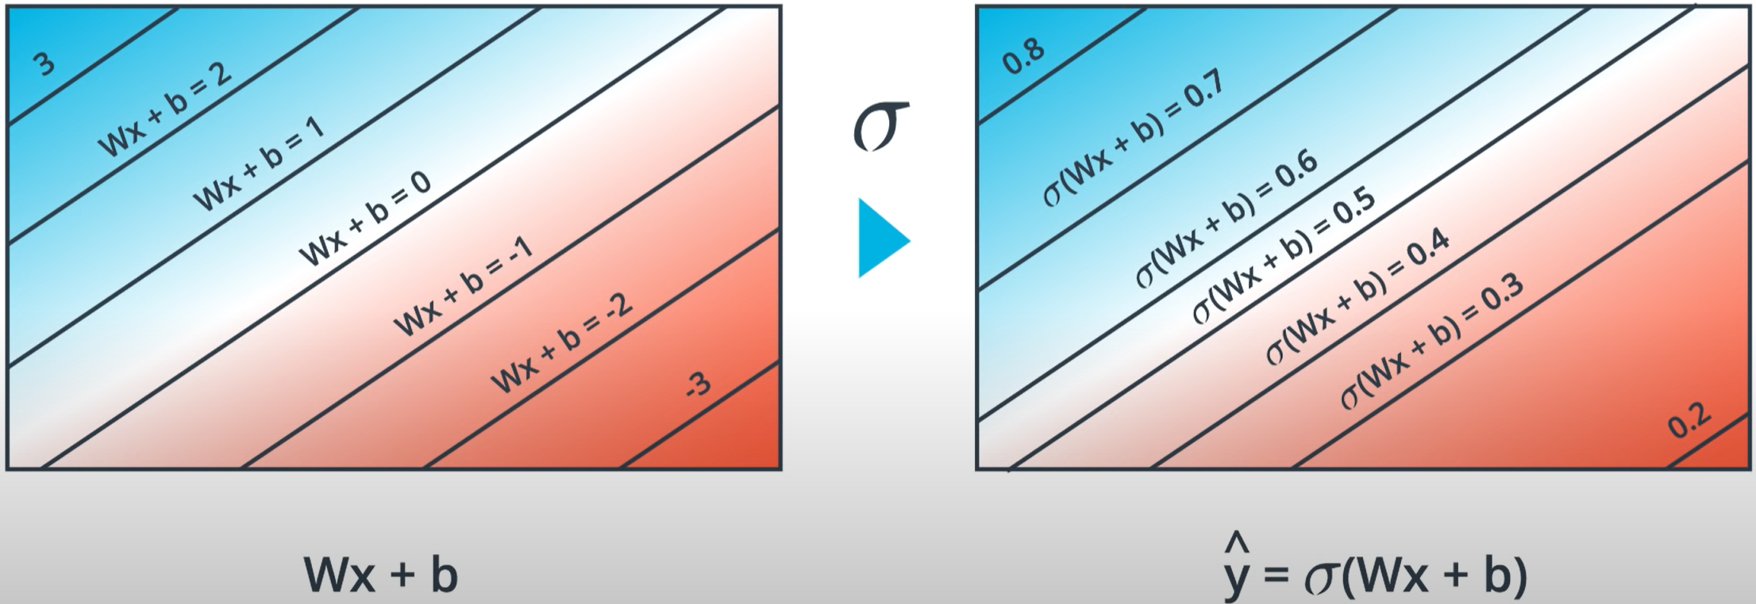
Logistic Regression
One Neuron - Neural Network
D.R. Cox 1958
Steps:
Randomly Initialize Weights (w) and Bias (b)
Logit calculation: z(x) = b + wx
Probability Calculation:
Error Function
Weights Update (Gradient Descent)

Slide 12
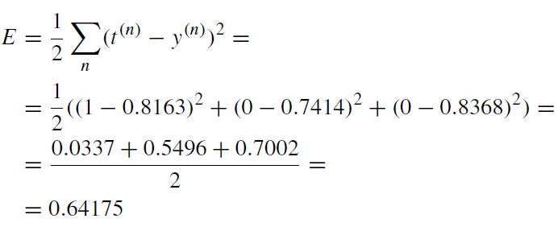
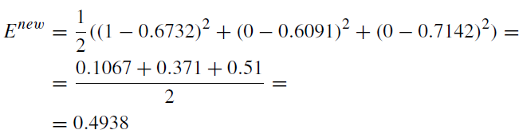
Logistic Regression
Example
yA = σ(0.66 + 0.1×0.2 + 0.35×0.5 + 0.7×0.91) = σ(1.492) = 0.8163
Points
xA = (0.2, 0.5, 0.91, 1)
xB = (0.4, 0.01, 0.5, 0)
x_{C} = (0.3, 1.1, 0.8, 0)
Ground Truth
tA = 1
tB = 0
t_{C} = 0
yB = σ(0.66 + 0.1×0.4 + 0.35×0.01 + 0.7×0.5) = σ(1.0535) = 0.7414
yC = σ(0.66 + 0.1×0.3 + 0.35×1.1 + 0.7×0.8) = σ(1.635) = 0.8368
y_{A}^{new} = σ(0.25 + 0.1×0.2 + 0.36×0.5 + 0.3×0.91) = σ(0.723) = 0.6732
Parameters
w = (0.1, 0.35, 0.7)
b = 0.66
y_{B}^{new} = σ(0.25 + 0.1×0.4 + 0.36×0.01 + 0.3×0.5) = σ(0.4436) = 0.6091
y_{C}^{new} = σ(0.25 + 0.1×0.3 + 0.36×1.1 + 0.3×0.8) = σ(0.916) = 0.7142
w^{new} = (0.1, 0.36, 0.3)
b^{new} = 0.25

Slide 13
Index
Gradient Descent
Logistic Regression
Introduction
Forward Pass
PyTorch
Neural Networks
Back Propagation

Slide 14
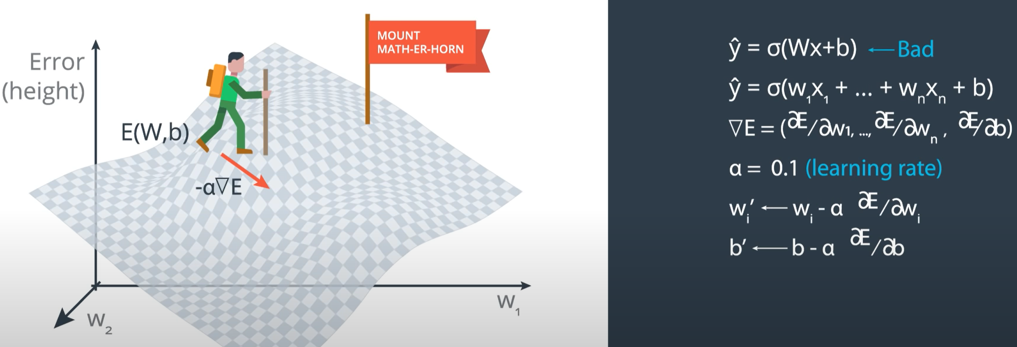
Gradient Descent
Weights Update Method

Slide 15

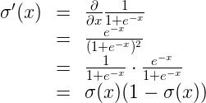
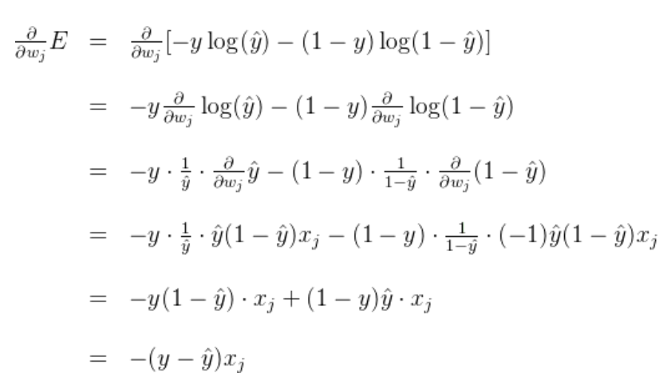
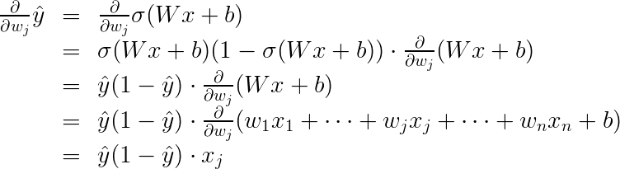
Gradient Descent
Weights Update Method

Slide 16
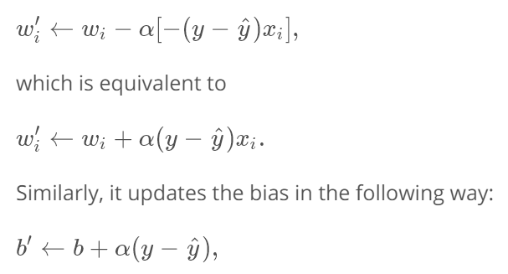
Gradient Descent
Weights Update Method

Slide 17
Index
Gradient Descent
Logistic Regression
Introduction
Forward Pass
PyTorch
Neural Networks
Back Propagation

Slide 18
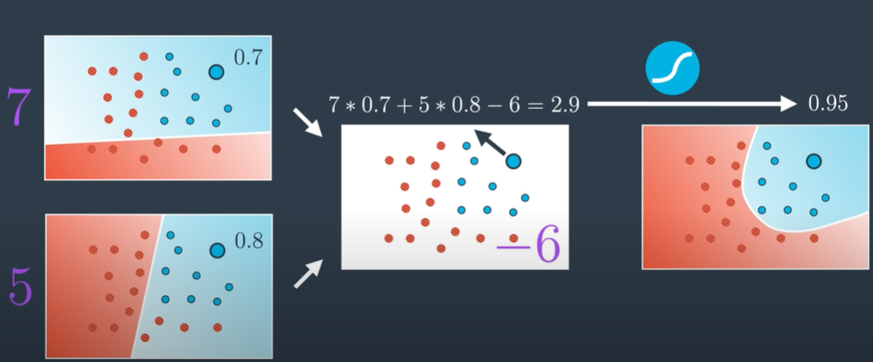
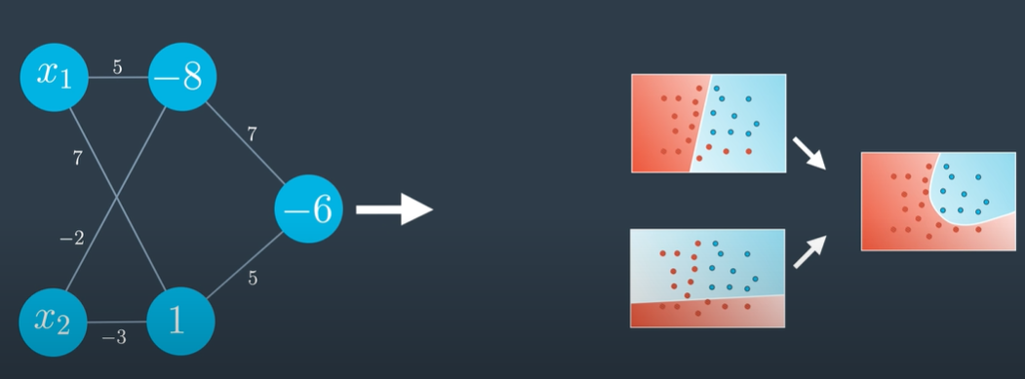
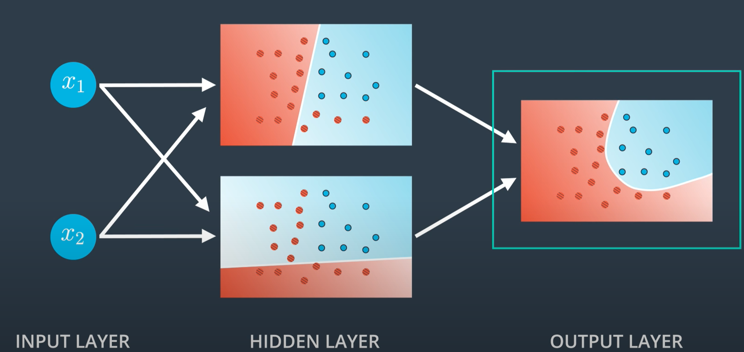
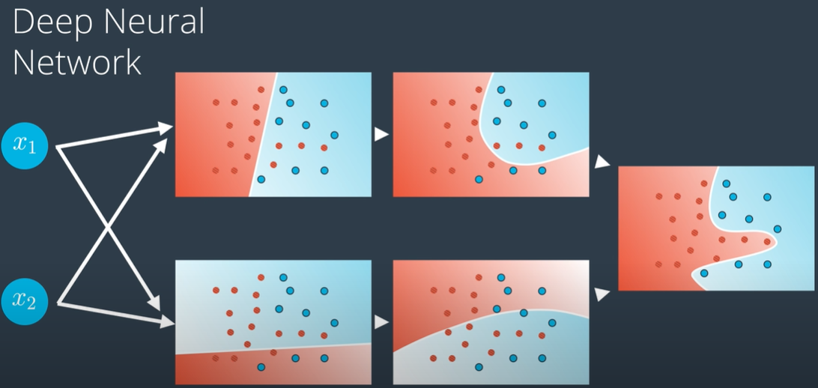
Forward Pass
What if we combine different linear models and apply nonlinearities?

Slide 19
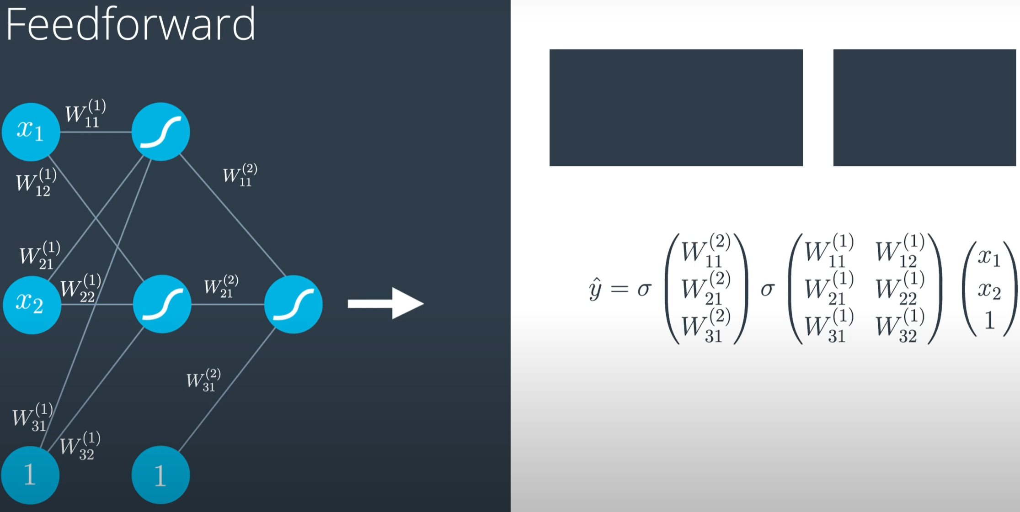
Forward Pass
Neural Network = Functions Composition
ŷ = σ( f²⁾( σ( f¹⁾(x))))
h₁ = σ(W₁₁⁽¹⁾x₁ + W₂₁⁽¹⁾x₂ + W₃₁⁽¹⁾)
σ( W₁₁⁽²⁾h₁ + W₂₁⁽²⁾h₂ + W₃₁⁽⁾ )
h₂ = σ( W₁₂⁽¹⁾x₁ + W₂₂⁽¹⁾x₂ + W₃₂⁽¹⁾ )

Slide 20
Index
Gradient Descent
Logistic Regression
Introduction
Forward Pass
PyTorch
Neural Networks
Back Propagation

Slide 21
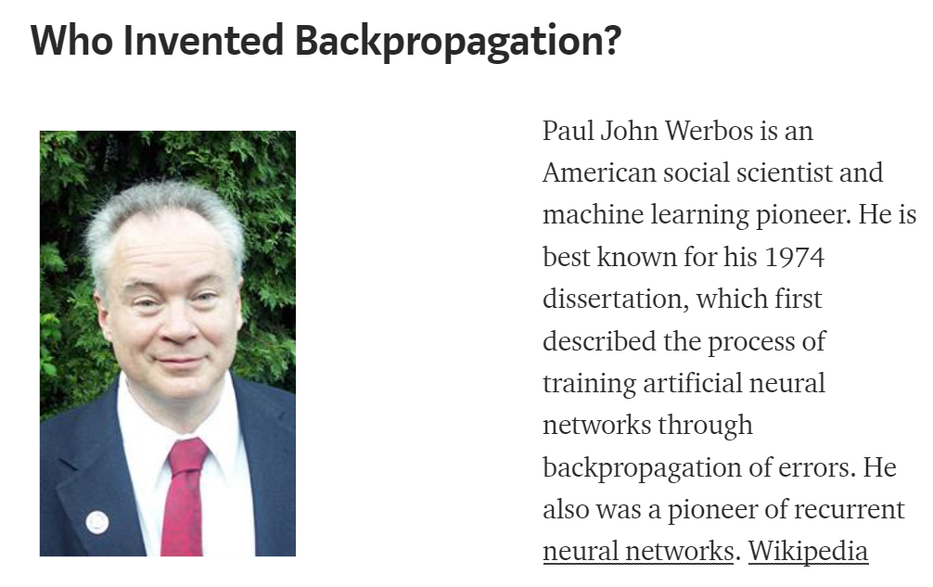
Backpropagation
Chain Rule for Gradient Descent Calculations

Slide 22
Backpropagation
Nested Gradient Descent
One iteration on a NN train process consists on:
Doing a feedforward operation.
Comparing the output of the model with the desired output.
Calculating the error.
Running the feedforward operation backwards (backpropagation) to spread the error to each of the weights.
Use this to update the weights, and get a better model.
Continue this until we have a model that is good.
CHAIN RULE!!!!!

Slide 23

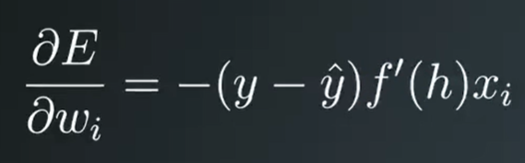

Backpropagation
Chain Rule for Gradient Descent Calculations

Slide 24
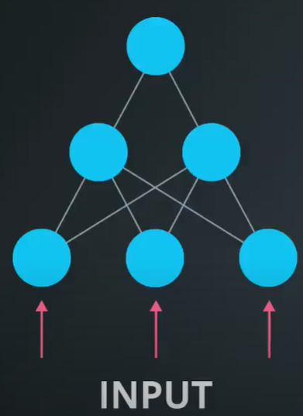
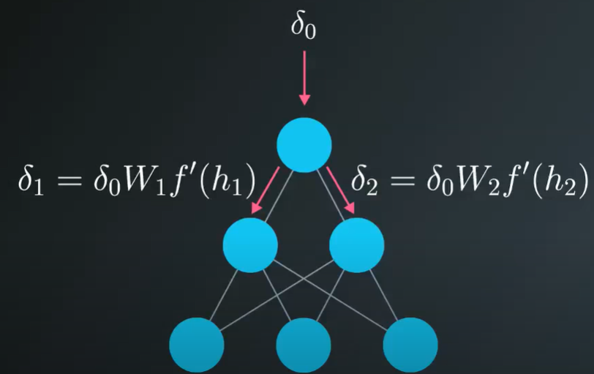
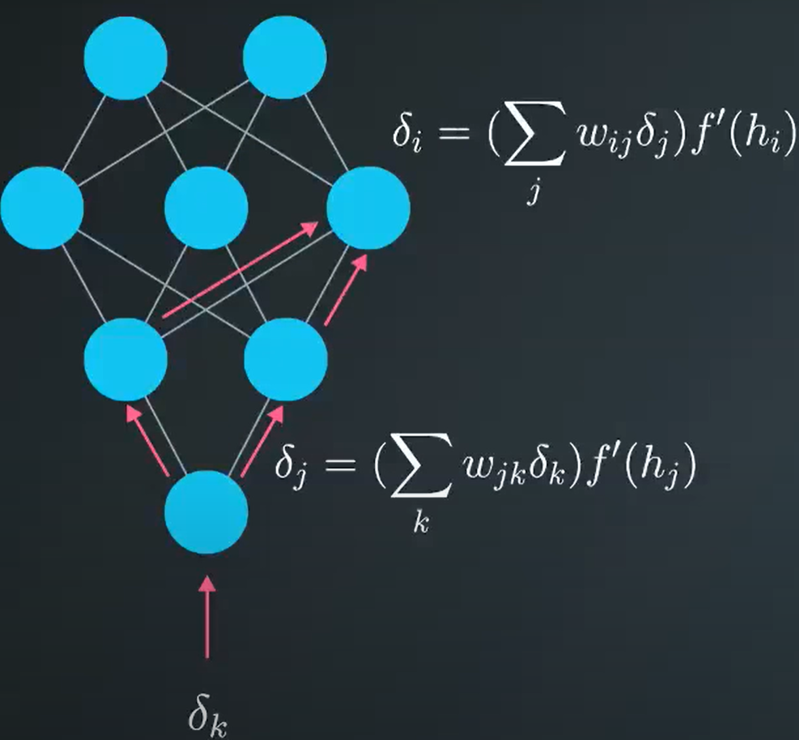
Backpropagation
Chain Rule for Gradient Descent Calculations
δ₀ = y - ŷ

Slide 25
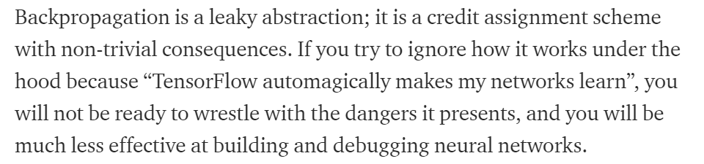

Backpropagation
Why is it worthwile to understand it and get familiar with it?
PyTorch

Slide 26
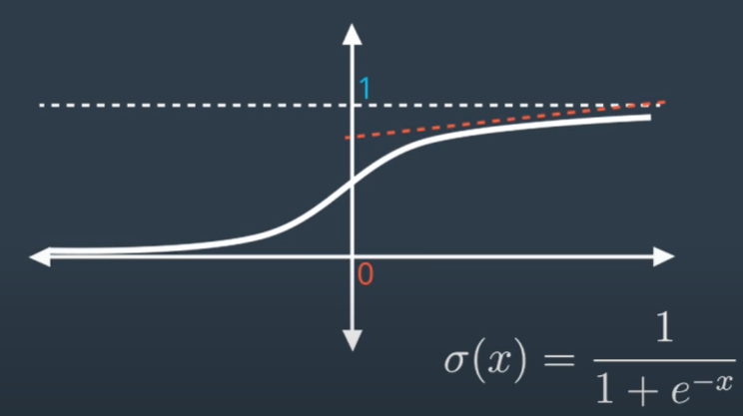
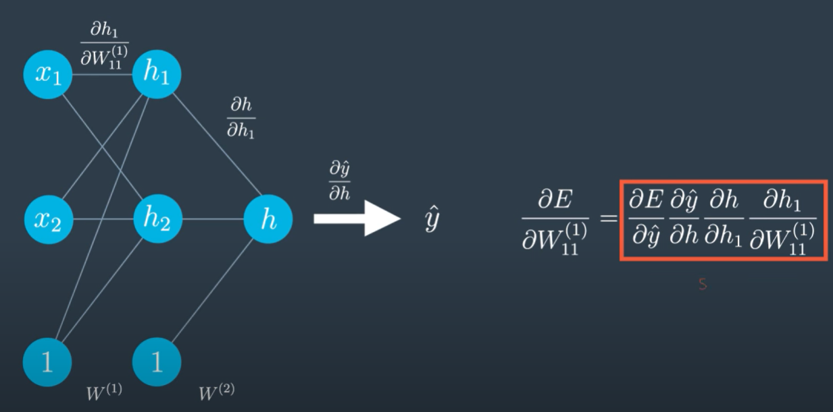
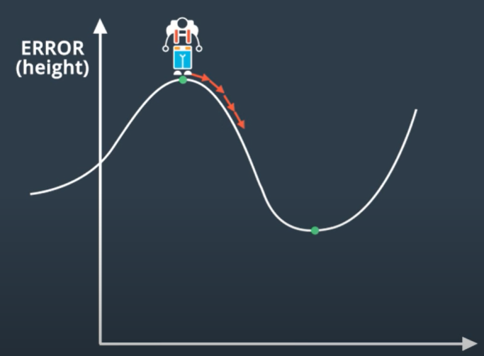
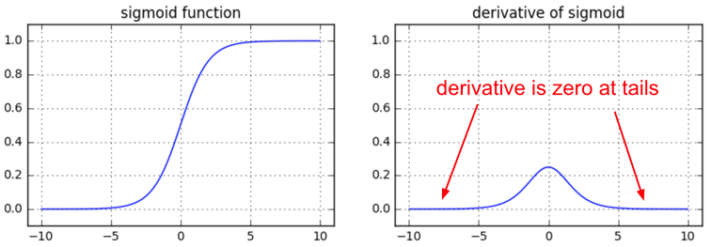
Backpropagation
Vanishing Gradients

Slide 27
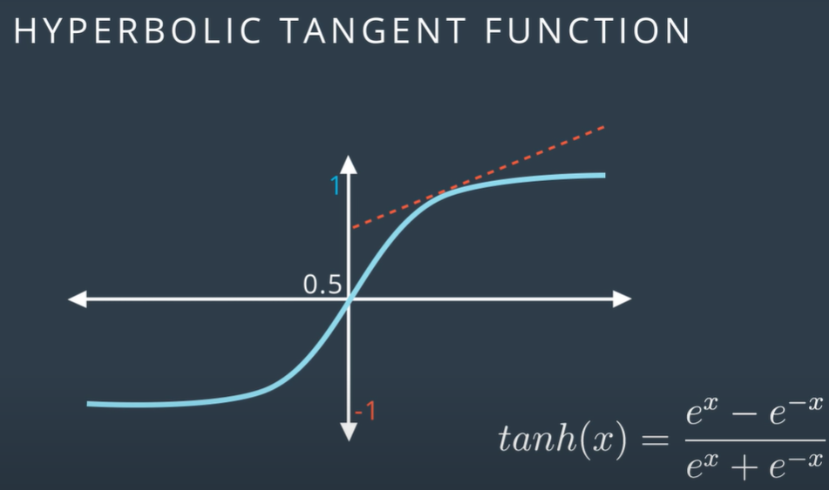
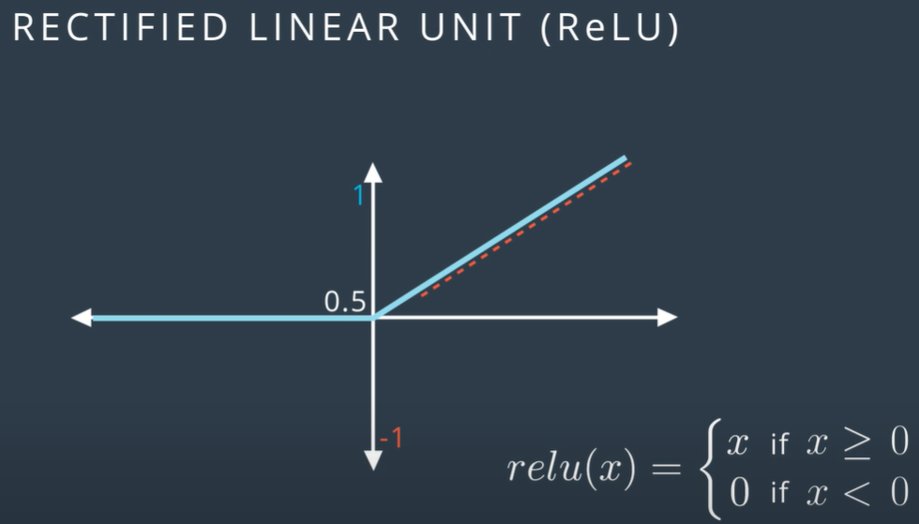
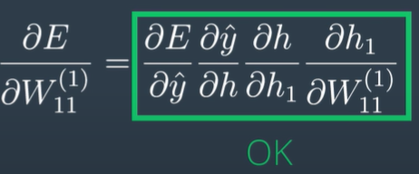
Backpropagation
Vanishing Gradients

Slide 28
Backpropagation
Vanishing Gradients

Slide 29

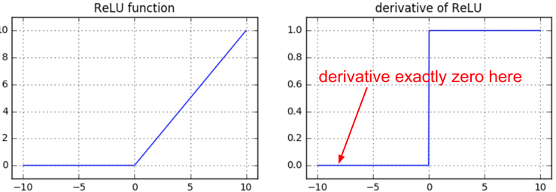
Backpropagation
Dying ReLUs
Bad Initialization Neuron doesn’t fire Gradient 0 Permanently Dead
If a neuron gets clamped to zero in the forward pass (i.e. z=0, it doesn’t “fire”), then its weights will get zero gradient. This can lead to what is called the “dead ReLU” problem, where if a ReLU neuron is unfortunately initialized such that it never fires, or if a neuron’s weights ever get knocked off with a large update during training into this regime, then this neuron will remain permanently dead. It’s like permanent, irrecoverable brain damage. Sometimes you can forward the entire training set through a trained network and find that a large fraction (e.g. 40%) of your neurons were zero the entire time.

Slide 30
Backpropagation
Dying ReLUs
Bad Initialization Neuron doesn’t fire Gradient 0 Permanently Dead
If a neuron gets clamped to zero in the forward pass (i.e. z=0, it doesn’t “fire”), then its weights will get zero gradient. This can lead to what is called the “dead ReLU” problem, where if a ReLU neuron is unfortunately initialized such that it never fires, or if a neuron’s weights ever get knocked off with a large update during training into this regime, then this neuron will remain permanently dead. It’s like permanent, irrecoverable brain damage. Sometimes you can forward the entire training set through a trained network and find that a large fraction (e.g. 40%) of your neurons were zero the entire time.

Slide 31
Index
Gradient Descent
Logistic Regression
Introduction
Forward Pass
PyTorch
Neural Networks
Back Propagation

Slide 32
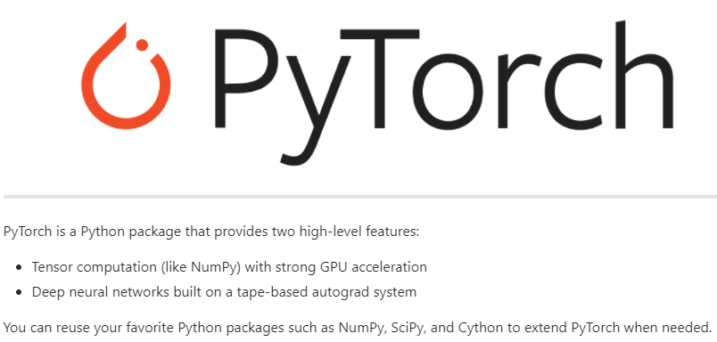
PyTorch
What is it?

Slide 33
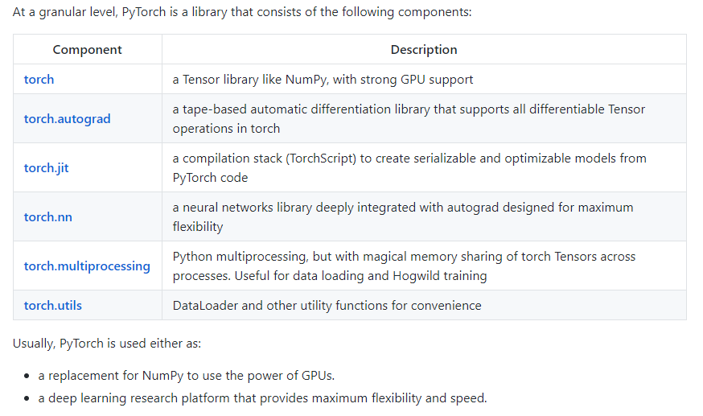
PyTorch
What is it?
Dynamic Neural Networks: Tape-Based Autograd
Python First
Imperative Experiences
Fast and Lean
Extensions Without Pain
https://github.com/pytorch/pytorch#more-about-pytorch

Slide 34
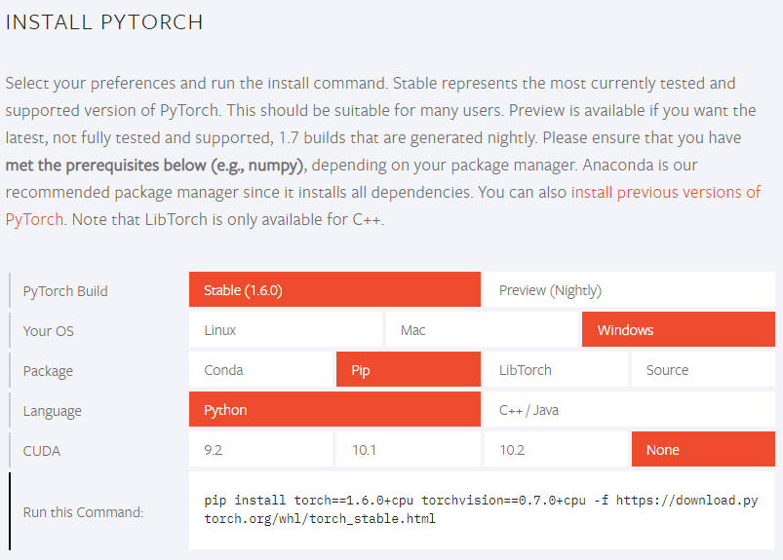
PyTorch
Installation
https://pytorch.org/

Slide 35
Resources
Some Interesting Links
http://www.deeplearningbook.org/ -> Deep book about Deep Learning
https://github.com/udacity/deep-learning-v2-pytorch.git
SUPER NLP REPO!!! https://notebooks.quantumstat.com/
Notes on BackPropagation https://cs231n.github.io/optimization-2/
Problems during Training: https://medium.com/@karpathy/yes-you-should-understand-backprop-e2f06eab496b#.vt3ax2kg9
Dying ReLUs: https://www.researchgate.net/publication/331858220_Dying_ReLU_and_Initialization_Theory_and_Numerical_Examples/link/5ce2210f92851c4eabaf9e43/download
“Introduction to Deep Learning: From Logical Calculus to Artificial Intelligence”. Sandro Skansi

